Slide 1
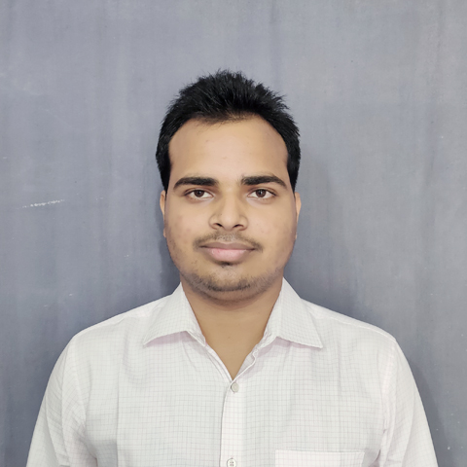



Krishna Kumar Vishwakarma
Analyst/Software Engineer
Bachelor of Technology
Computer Science : 2018 - 2022
Skills
Java 8 /J2EE | Java Basics, OOPS, Generics, Collections, Arrays, Loops, Lambda Exp, Stream API Junit, Mockito, Servlets
Spring core | IOC & Dependency Injection, Autowire
Spring REST | REST controllers, Implementation of GET, POST, PUT & DELETE, Bean Validation & Exception Handling, Testing Services, Controller & Repository layer
Spring Data JPA | Implement DAO layer using spring Data repositories, Transaction Management
Spring Boot Microservices | Microservice Architecture, Spring Boot Starters, annotations, Messaging Service, Swagger API specifications
Spring Cloud | Eureka Server & API Gateway
React | Components, Hooks, Event handling , axios , routing
Database | MongoDB No Sql Basics ,My SQL Basics
UI Tech | HTML 5 & CSS 3,JavaScript, Bootstrap
Tools | Git, Postman, Maven, IDE
Add On skills | Time management, Team management. Peer learning
Mumbai
krishna-kumar.vishwakarma@capgemini.com
+91 8172940797
A4
Full Stack Developer​
Hands on experience in creating microservices with Spring boot, Spring Security, Spring Cloud API Gateway, Eureka server.
Hands on experience in creating Single page Web Application in React.
Experience in creating documentation with swagger and in unit testing using Junit and messaging service using rabbitMQ and email service.
Development experience in creating docker compose files, docker images and pushing to Docker Hub.
Understanding of AWS Cloud environment
Pharmacy Management Application
Completed end to end case study of Pharmacy Management Application along with spring boot security, Swagger and Email service using SMTP, UI with ReactJS used for user interface.​.
CAMP TRAINING in Capgemini on JEE with Devops and AWS
Check out my work on GitHub & Video Profile

